Slide 1
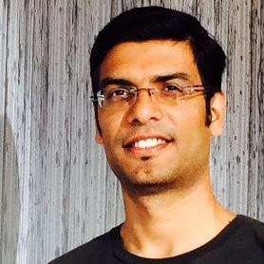
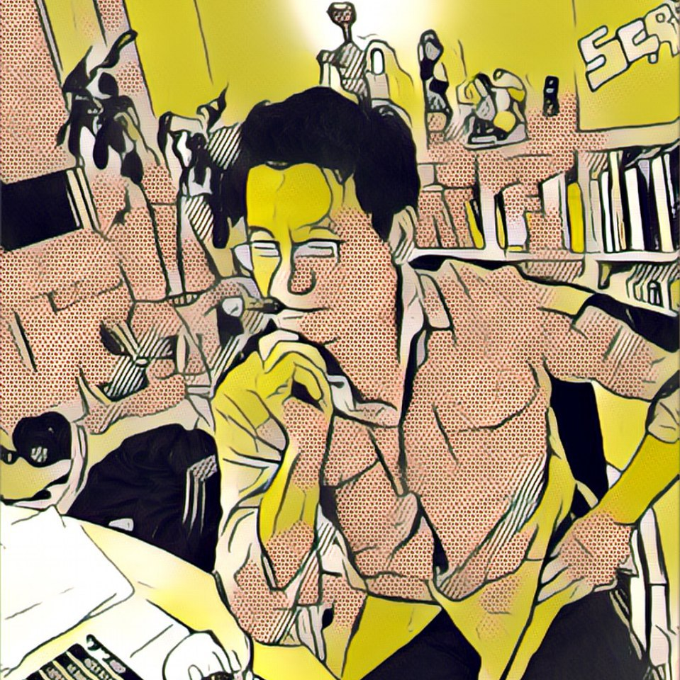


Oasis: Who We Are
Kishore Bhatia
Bernard Lin
Alan Wang
Ling Zhong
@BhatiaKishore
@Pblin
@Haohaoski
@blingalingz

Slide 2




Three features on a consortium chain to optimize the flow of goods, money and information
Frank Fichera
Farms
Producers
Flow of Goods
Flow of money
Packaging barcode logged
on chain; track provenance
through scanner
SproutCoin paid upon receipt; onchain redemption contract triggers offchain payment process
Grow NYC
Flow of information
Customers
GreenMarkets
Fresh Food
Box
Wholesale
customers
Customers rate producers to signal preference
GrowNYC monitors to identify and promote best farms
GrowNYC runs permissioned consortium chain with Quorum
Ecosystem will require ~20 wholesale customers as nodes, incentivized with SproutCoin

Slide 3
Oasis ecosystem overview
Frank Fichera
Farms
MVP Features
Package barcode on chain with full readable provenance
Payment in Sprout Token with redemption contract
End customers share to signal preference
Producers
1
Grow NYC
2
3
Customers
GreenMarkets
Wholesale
customers
Senior Home
GrowNYC runs permissioned consortium chain with Quorum
Ecosystem will require ~20 wholesale customers as nodes, incentivized with SproutCoin

